Slide 1
Learn JavaScript with fun, build an UFO hunter game UFO Hunter game plan

Slide 2
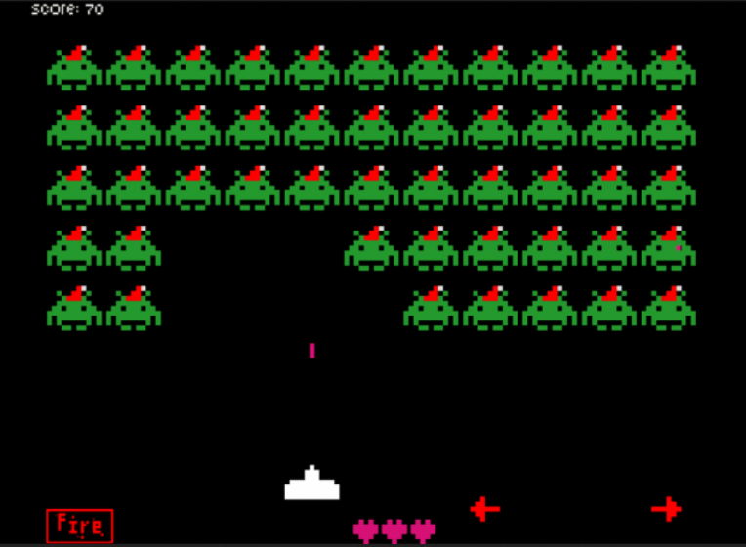
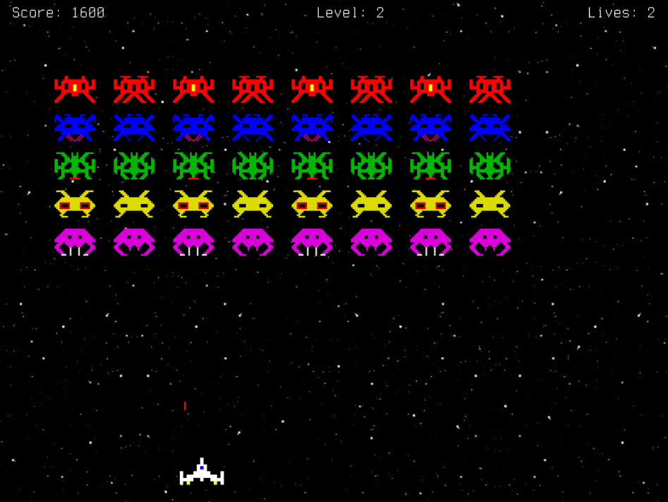
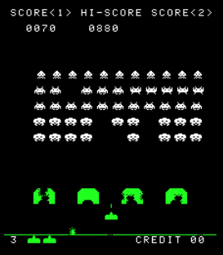
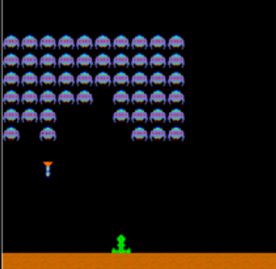
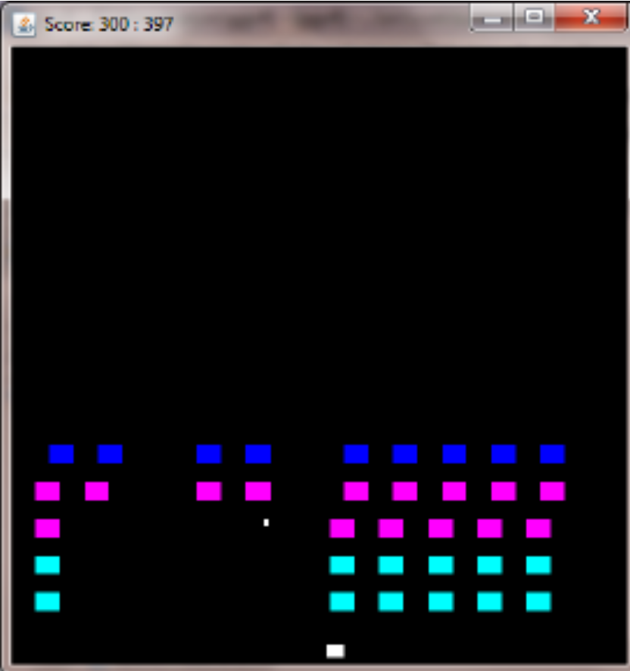
UFO Hunter game plan
Space Invaders is a 1978 arcade game created by Tomohiro Nishikado. Within the shooter genre, Space Invaders was the first fixed shooter and set the template for the shoot 'em up genre. The goal is to defeat wave after wave of descending aliens with a horizontally moving laser to earn as many points as possible.
Space Invaders has been remade on numerous platforms and spawned many sequels with slightly modified gameplay, like Alien Invaders, MiniVader, Alien Attack, Microspace Invaders, Galaxions, Space Strike, and so on. We are going to make a game like this!

Slide 3
UFO Hunter game plan
UFO Hunter is an old style shooter game in which the player controls a space ship by moving it horizontally across the bottom of the screen and firing at descending ufos. The aim is to defeat four rows (in eight columns) of enemy ufos that move horizontally back and forth across the screen as they advance towards the bottom of the playfield while they attempt to destroy our space ship by firing at it. The player defeats an alien, and earns points, by shooting it with the ships laser. Defeating the ufos brings another wave that is more difficult because ufo's movement speed up.

